Slide 1
Readiness and Emergency Management for Schools (REMS) Technical Assistance (TA) Canter- Cybersecurity Considerations for Institutions of Higher Education
Student Name:
Institution Affiliation:

Slide 2
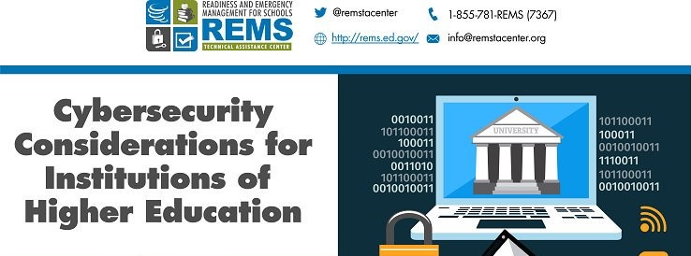
Overview
Characteristics of a safe and supportive learning environment
Robust information technology networks and multi-layered information systems
Breach types within institutions of higher education (IHE)
Cybersecurity planning, education, and training in institutions of higher education.
Federal regulations on cyberattacks
Notes:
Cybersecurity needs to be a major consideration in institutions of higher education. An effective learning environment need the ability of securely connect to virtual systems. Students and staff need to have access to digital learning without much fear of cyberattacks. All IHE need to have the best information technology networks that provide higher levels of access and connectivity. The most breach types in IHE that need to be addressed are hacking/malware and unintended disclosure. Any attach in IHE has robust effects hence the need for all stakeholders in the IHE to be involved in the cybersecurity planning, education and training. Family Educational Rights and Privacy Act (FERPA), Federal Information Security Modernization Act of 2014 (FISMA 2014), Gramm-Leach-Bliley Act (GLBA), Health Insurance Portability and Accountability Act (HIPAA), Health Insurance Portability and Accountability Act (HIPAA), and Student Aid Internet Gateway (SAIG) Enrollment Agreement are the main federal regulations that require IHE to ensure confidentiality, security and privacy of general information and personally unidentifiable information (Liu, Huang, & Lucas, 2016).

Slide 3
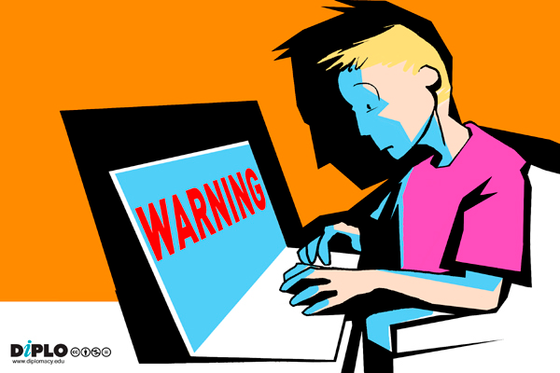
Threats Facings IHE Networks and Systems
CISOs Within IHEs responsibility
Cloud security
Denial of Service (DOS)
Malware
Phishing
Unsecure personal devices
Notes:
CISOs within IHEs have a greater responsibility of protecting, securing and storing greater and confidential information. The CISOs need to work closely with cyber security teams to eliminate the following threats facing IHE networks and systems. The use of cloud computing services involves the storing of data on third-party servers that are easily accessible over the internet. During DOS attacks all individuals with official authority to view data are denied the ability. Next, a malware occurs when unrequested software are injected in the IHE’s servers. Phishing- obtaining of personally identifiable information on the other hand is done by malicious individuals or groups. The program of BYOE within the learning environment may threaten the data security due to the use of some unsecure personal devices (McGettCassel, Dark, Hawthorne, & Impagliazzo, 2014).

Slide 4
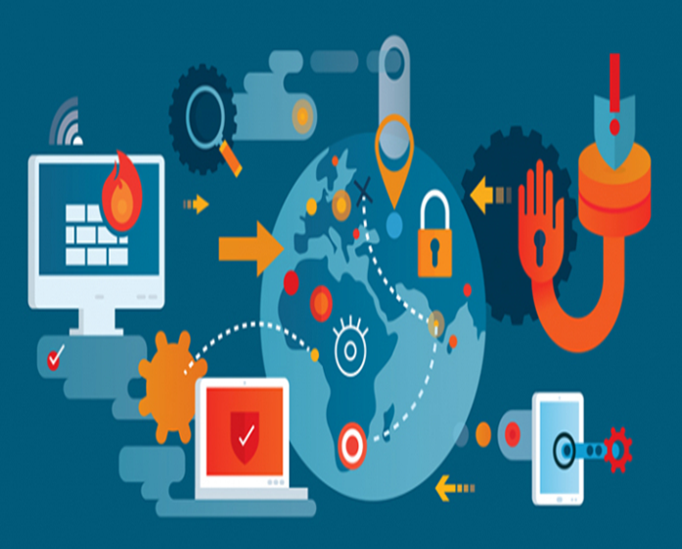
Preparing for Threats
Securely store data
Create access control lists and firewalls
Develop policies on secure deployment, maintenance, and responsible/acceptable use.
Monitor networks carefully
Notes:
Implementation of various means of protection, prevention and other mitigation strategies for use by all IHEs will help prepare for cyber threats. THE CISOs, the emergency department, and the cybersecurity staff should work in collaboration with each other to ensure that they constantly monitor all the emerging and new technologies and information security techniques within the IHEs. Collectively, they need to ensure that they securely store data, create access control lists and firewalls, develop policies on secure deployment, maintenance, and responsible use, and lastly monitor networks carefully (Gunter, 2016).

Slide 5
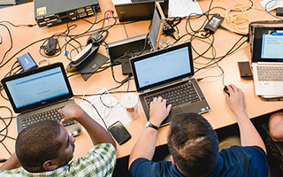
Responding to Threats
Identification of the threat
Collaboration with external players
Change to information security protocols
Response guidance and outline of course of action
Notes:
For better response of the threats within the IHEs, the type of threat has to be detect first. For instance, a financial data threat gets a different response from that of a student information data threat. The CISOs, the emergency management team, and the cybersecurity team should work in collaboration with external players such as FBI, other IHEs, and Private data security firms. All these will help in precise mitigation of the threat. Next, as a way of responding to the threats, the information security protocols of the affected department need to be changed to avoid further threats. Lastly, a response guide and outline of courses of action for various threats need to be precisely considered (McGettCassel, Dark, Hawthorne, & Impagliazzo, 2014).

Slide 6
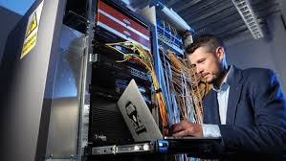
Recovering from Threats
Focus on technology, policies and people.
Involvement of technology, policies and people in recovery planning
Notification to all affected
Awareness of possibly implemented policies to prevent future attacks
Notes:
The entire recovery process need to be focused on technology, policies and people. IHEs CISOs need to involve all the three parties in each step of recovery to ensure better recovery plans are designed. In attempts of restoring the affected unit, all the impacted stakeholders need to be informed of the contingency plans taken. The entire recovery team including CISOs, Emergency management teams, cybersecurity and IT need take steps to review, revise, train, and continually remind key stakeholders on policies that may be implemented to prevent future attacks (Gunter, 2016).

Slide 7
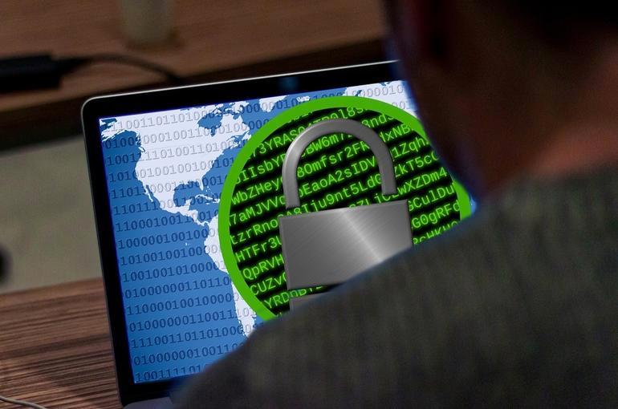
Relation to Emergency Operation Plans Development and Planning
Step1 : Form a Collaborative Planning Team
Step 2: Understand the Situation
Steps 3 & 4: Develop Goals, Objectives, and Courses of Action
Step 5: Plan Preparation, Review, and Approval
Step 6: Plan Implementation and Maintenance
Notes:
The cybersecurity and planning team should ensure that they follow the six-step planning [process when developing emergency operations plans as outlined in the IHE guide. First, only designated personnel with cybersecurity and managing cyber incidents and emergencies knowledge should comprise the cybersecurity planning team. Secondly, understanding of the potential cyber threats that may impact their IHE Community is vital. Via the utilization of the threats identified, the team should work to develop objectives and goals. The plan connection to state, country and even municipal plans should also be identified. Lastly, after the plan is finalized, it remains essential for all stakeholders to be trained Liu, Huang, & Lucas, 2016).

Slide 8
References
Liu, C. W., Huang, P., & Lucas, H. C. (2016). IT Governance, Security Outsourcing, and Cybersecurity Breaches: Evidence from the US Higher Education.
Gunter, T. (2016). Qualitative Collective Case Study of Targeted Violence Preparedness at Institutions of Higher Education.
McGettCassel, L. N., Dark, M., Hawthorne, E. K., & Impagliazzo, J. (2014, March). Toward rick, A., curricular guidelines for cybersecurity. In Proceedings of the 45th ACM technical symposium on Computer science education (pp. 81-82). ACM.

